Slide 1
Firefox & IE Configuration
Ryan Kim

Slide 2
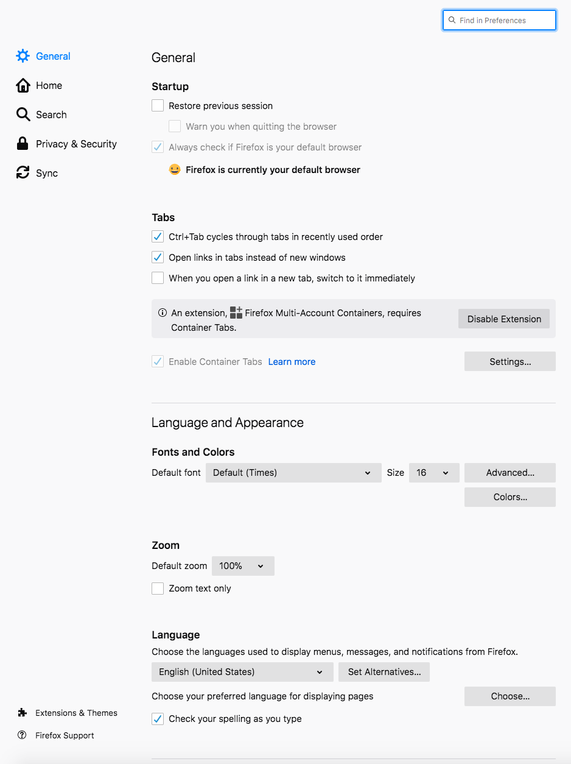
Firefox - Graphical Settings
about:preferences
Make sure Firefox is the default browser
Check Privacy & Security Tab

Slide 3
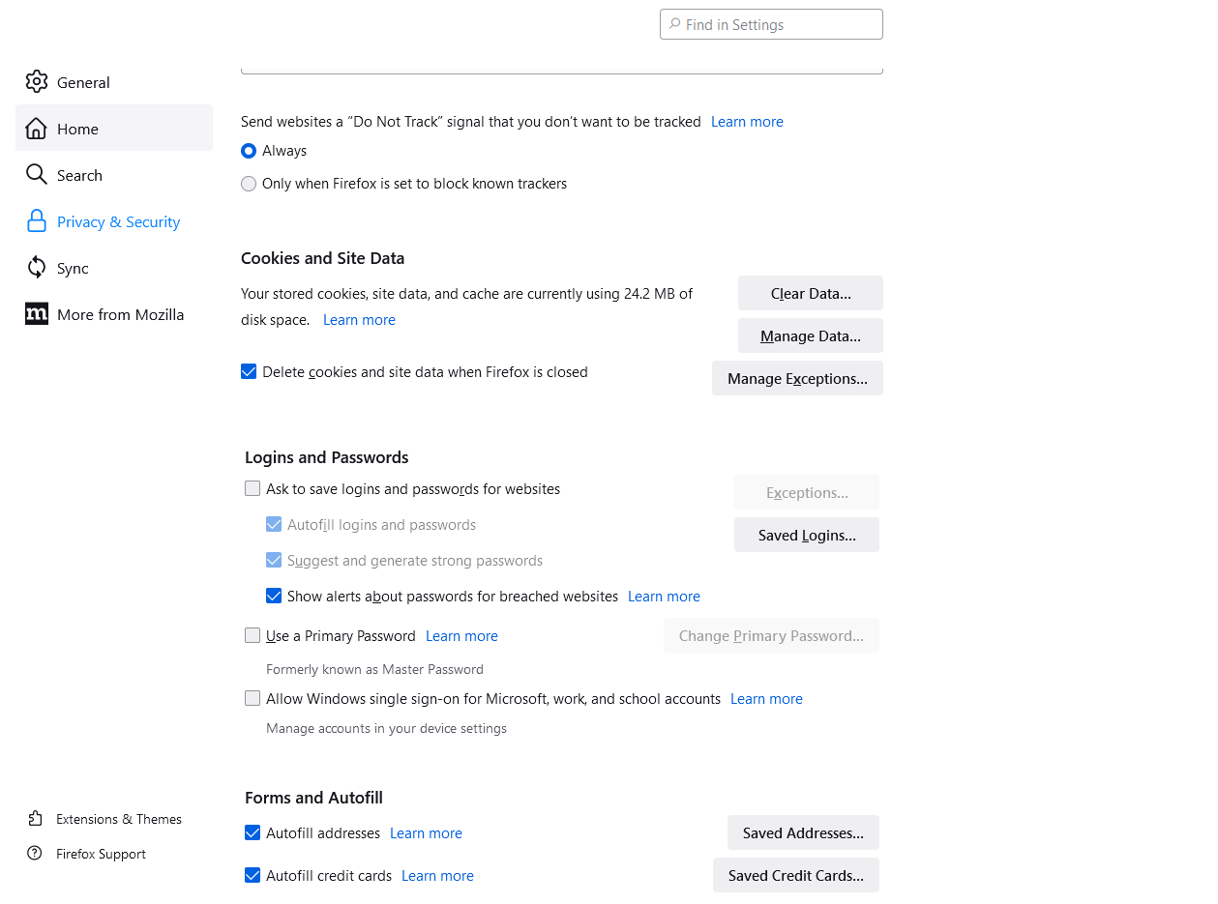
Firefox - Security Settings
Always send do not track
Delete cookies and site data
Do not save logins and passwords
Show alerts for passwords
Block pop-up windows
Warn when websites try to install add-ons
Block dangerous and deceptive content
Ask every time for certificates
Enable HTTPS only mode

Slide 4
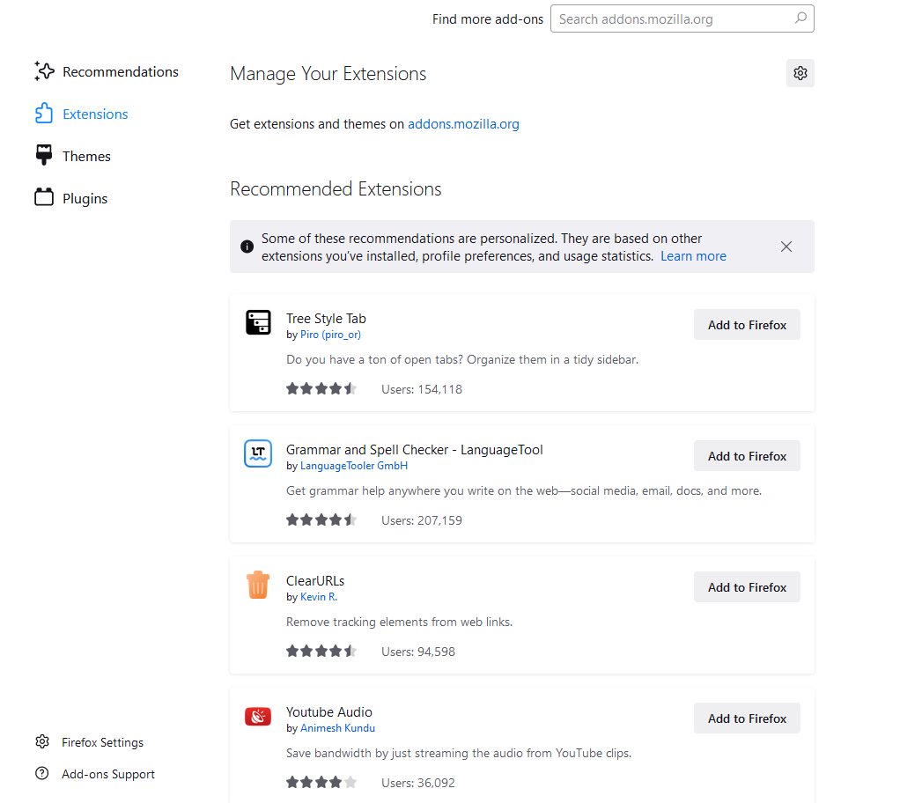
Firefox - Add-ons
search in search bar : about:addons
Make sure to remove extensions and plugins

Slide 5
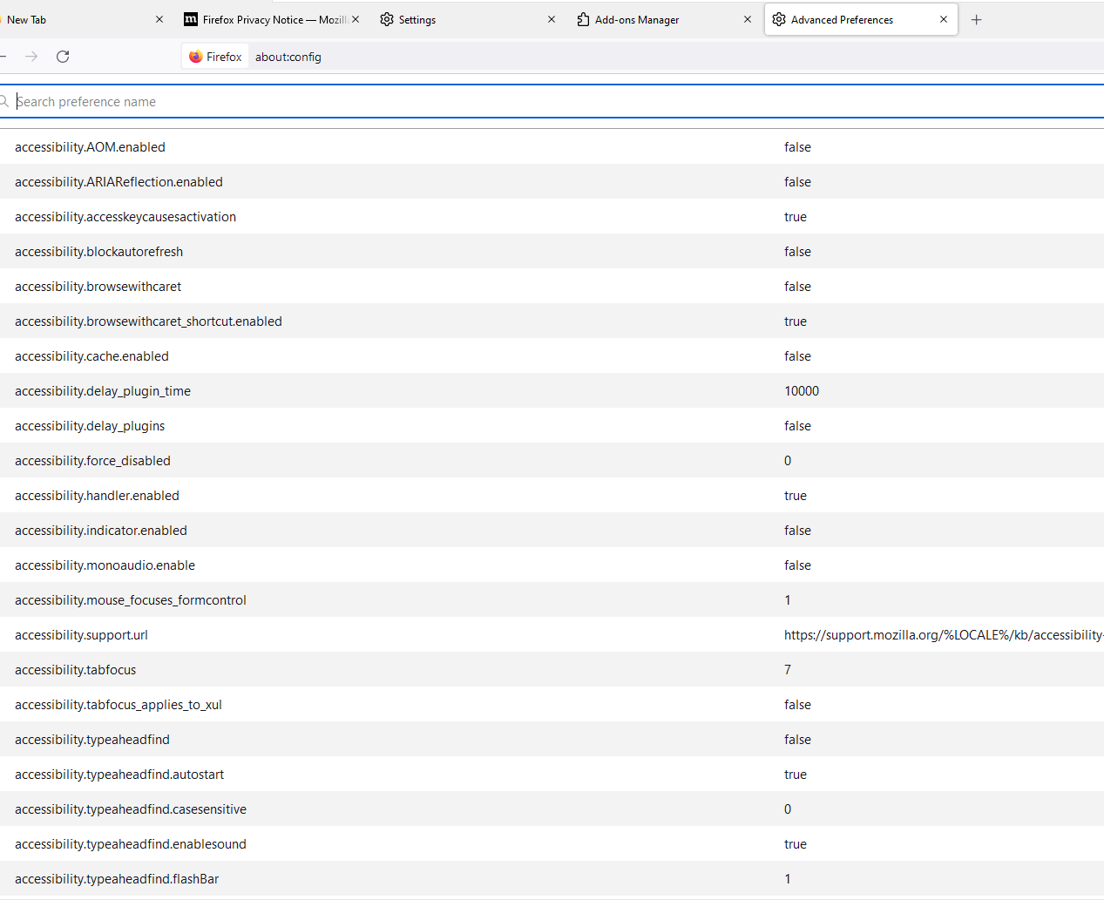
Firefox - Config Mode
search in search bar: about:config
bold indicates that the setting is not default

Slide 6
Firefox - Configuration Files
Stores info for about:config
Windows path: C:\Users\%USERNAME%\AppData\Roaming\Mozilla\Firefox\Profiles\some folder\prefs.js
Linux path (not as root): ~/.mozilla/firefox/something.default/prefs.js
Secure Config file: https://github.com/pyllyukko/user.js/
More info here: https://support.mozilla.org/en-US/kb/profiles-where-firefox-stores-user-data

Slide 7
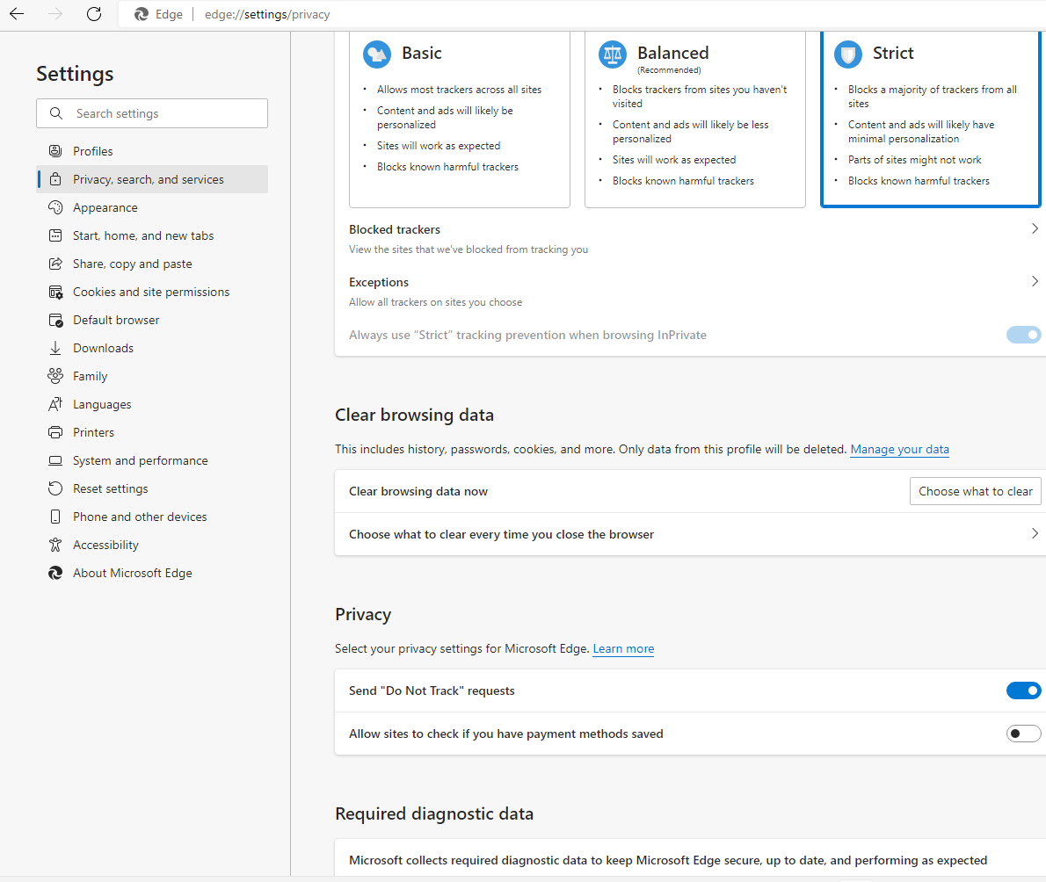
Internet Explorer - Privacy, Search, and Services
Strict Security
Send do not track requests
Do not save passwords/Payment Info
Security Tab
Set all zones to max security level
Enable Protected mode for everything
Privacy
Checkmark everything
Disable Add-ons
Check ask to download
Advanced
Review the security settings
Optimize Performance

Slide 8
Internet Explorer - Group Policy
Path: Admin Templates -> Windows Components -> Internet Explorer
Most important subdirectories: Privacy & Security Features
Relevant settings are in the Internet Explorer CIS Benchmark

